Slide 1


React JS
(jsx)
Lecture- 4

Slide 2
Today’s Agenda
What is JSX ?
Why JSX ?
Characteristics Of JSX ?
Coding JSX
Expressions In JSX
Inserting A Large Block Of HTML
Summary

Slide 3
What Is JSX ?
To understand this , take a look at the code given below :
What do you think it is ?
Is it JavaScript or is it HTML ?
The answer is NONE.
It is called JSX.
let myElement = <h1>Hello User!</h1>;

Slide 4
What Is JSX ?
JSX stands for JavaScript Syntax Extension.
It is used in React to easily write HTML and JavaScript together.

Slide 5
Why JSX?
Using React.createElement() was the old way of writing code in React .
However it's tedious to write the React.createElement() every time, even for adding a simple div.
So React introduced the JSX way of writing code which makes code easy to write and understand.

Slide 6
Why JSX?
JSX can easily convert HTML tags to react elements.
It is faster than regular JavaScript.
JSX allows us to put HTML elements in DOM without using appendChild() or createElement() method.

Slide 7
Coding JSX
Let us understand the benefit of JSX with two examples, the first uses JSX and the second does not:
Example 1: With JSX
Example 2: Without JSX
let myelement = <h1>Hello User!</h1>;
ReactDOM.render(myelement, document.getElementById('root'));
let myelement = React.createElement(‘h1’, null , “Hello User”);
ReactDOM.render(myelement,document.getElementById('root'));

Slide 8
How Will Browser Understand JSX ?
The browser does not understand this JSX because it's not valid JavaScript code.
This is because we're assigning an HTML tag to a variable that is not a string but just HTML code.

Slide 9
How Will Browser Understand JSX ?
So to convert it to browser understandable JavaScript code, we use a tool called Babel which is a JavaScript compiler.

Slide 10
What Is Babel ?
Babel is a JavaScript Compiler.
Babel is a tool that is mainly used to convert ECMAScript 2015+ code into a backwards compatible version of JavaScript in current and older browsers or environments.

Slide 11
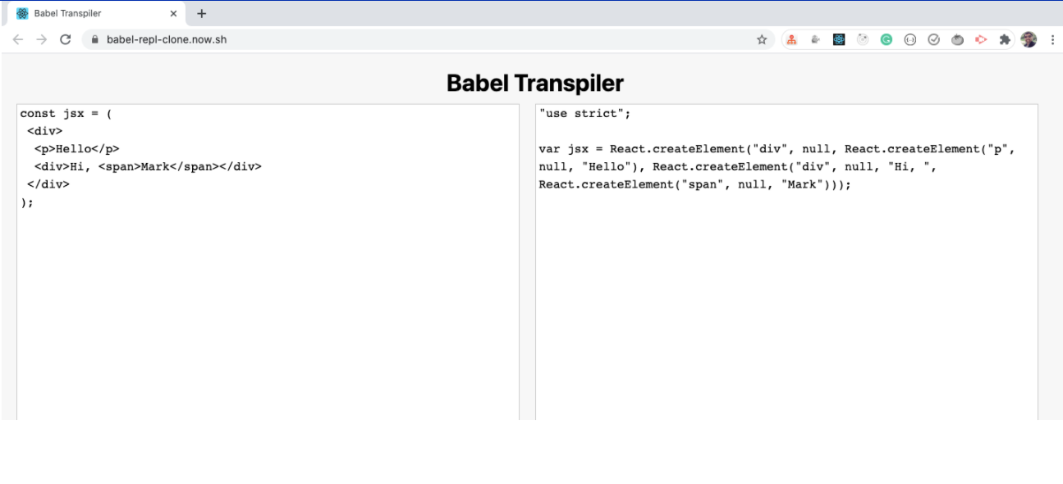
What Is Babel ?

Slide 12
How To Add Babel To Our Code ?
To add Babel we need to reference another library.
Just below the two script tags, add the following line:
Here we’re adding a reference to the Babel JavaScript compiler (http://babeljs.io/).
Babel does many cool things, but the one we care about is its capability to turn JSX into JavaScript.
<script src="https://unpkg.com/@babel/standalone/babel.min.js"></script>

Slide 13
A Very Important Point
Since we are using babel and JSX , so the we will have to set the type attribute also with our <script> tag .
The value of type attribute should be “text/babel”.
<script type=“text/babel”>
// JSX code
</script>

Slide 14
The Final Code
<!DOCTYPE html>
<html lang="en">
<head>
<title>Using React With CDN</title>
<script crossorigin src="https://unpkg.com/react@17/umd/react.development.js">
</script>
<script crossorigin
src="https://unpkg.com/react-dom@17/umd/react-dom.development.js">
</script>
<script src="https://unpkg.com/@babel/standalone/babel.min.js"></script>
</head>
<body>
<div id="root"></div>
<script type=“text/babel”>
let myElement = <h1>React Rocks!!!</h1>;
let mydiv = document.querySelector("#root");
ReactDOM.render(myElement, mydiv);
</script>
</body>
</html>

Slide 15
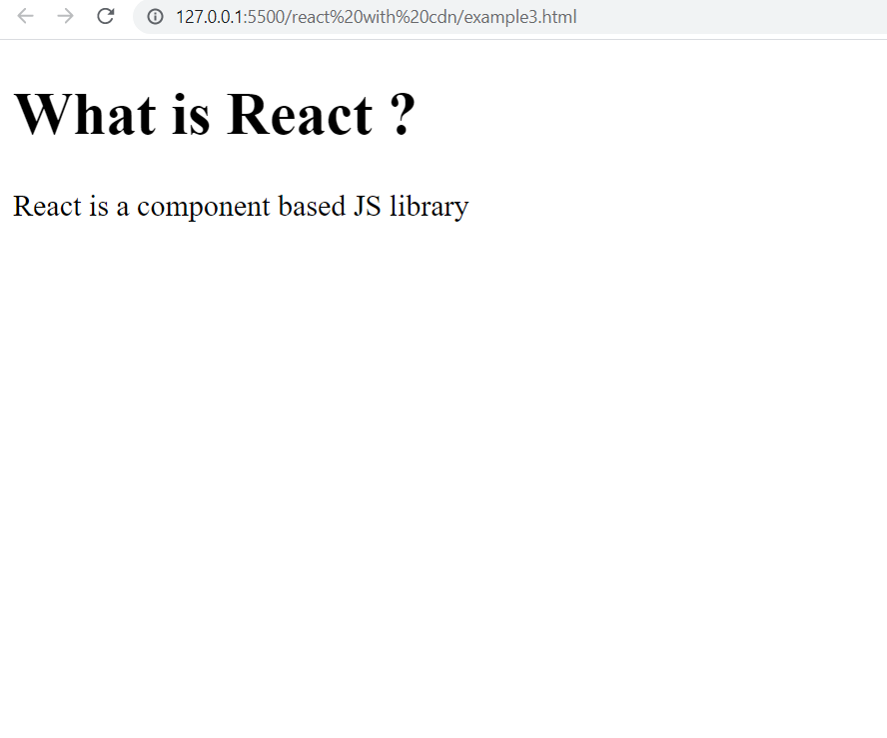
Exercise
Design the following App using JSX
Make sure to use function for returning your React element

Slide 16
Solution
<script type=“text/babel”>
function MyApp() {
let myElement = (
<div>
<h1>What is React ?</h1>
<p>React is a component based JS library</p>
</div>
);
return myElement;
}
let mydiv=document.querySelector("#root");
ReactDOM.render(React.createElement(MyApp),mydiv);
</script>

Slide 17
A Very Important Point
Since we are using Babel, so React allows us to simplify the call to render() method also.
This can be done by passing the name of our function as a tag as the first argument to render()
let mydiv = document.querySelector("#root");
ReactDOM.render(<MyApp />, mydiv);

Slide 18
Modified Solution
<script type=“text/babel”>
function MyApp() {
let myElement = (
<div>
<h1>What is React ?</h1>
<p>React is a component based JS library</p>
</div>
);
return myElement;
}
let mydiv=document.querySelector("#root");
ReactDOM.render(<MyApp/>,mydiv);
</script>

Slide 19
Expressions In JSX
With JSX we can write JavaScript expressions inside curly braces { }.
The expression can be a React variable, or property, or any other valid JavaScript expression. JSX will execute the expression and return the result:
Example: Execute the expression 5+5
let myelement = <h1>React is {5 + 5} times better with JSX</h1>;

Slide 20
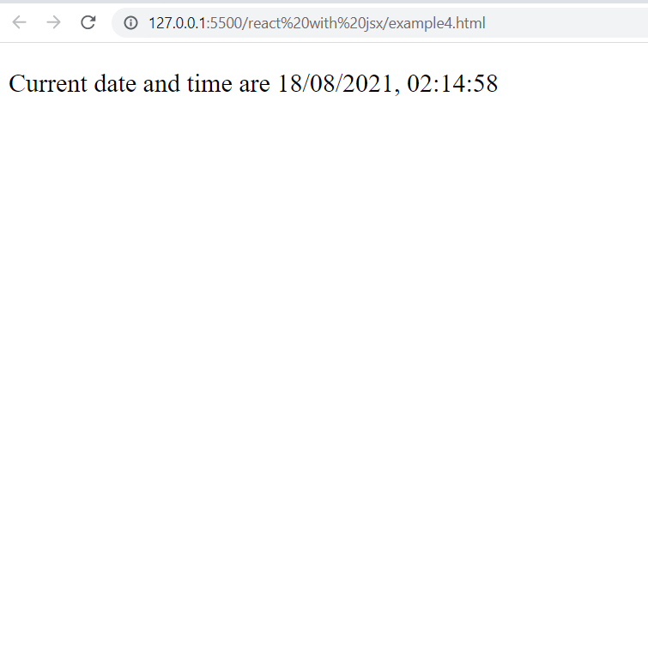
Exercise
Design the following App using JSX to create a function that returns a React element representing the current date and time in local time zone

Slide 21
Solution
<script type=“text/babel”>
function MyApp() {
let now = new Date().toLocaleString();
return <p>Current date and time are {now} </p>;
}
let mydiv=document.querySelector("#root");
ReactDOM.render(React.createElement(MyApp),mydiv);
</script>

Slide 22
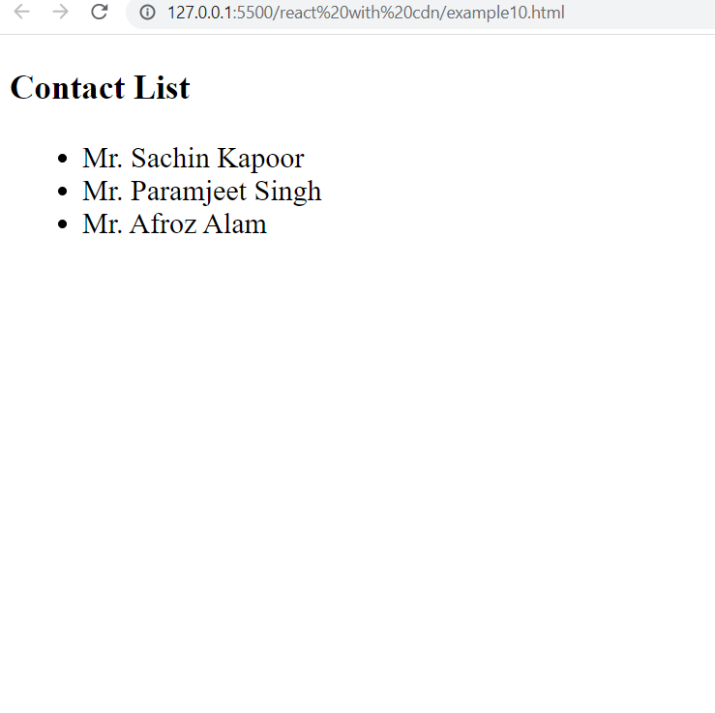
Exercise
Design the following App using JSX
Make sure to use function for returning your React element

